Slide 1
North Central Illinois Perinatal Network
Education Updates
August 2024

Slide 2
Me First, New Mom Relaunch
Why is this important?
Visual reminder to patients for post birth warning signs
Very helpful to EMS and ED staff to identify patients who have been pregnant recently
Education Roll Out:
Patient education material
Staff discharge education
EMS/ED staff quick reference guide

Slide 3
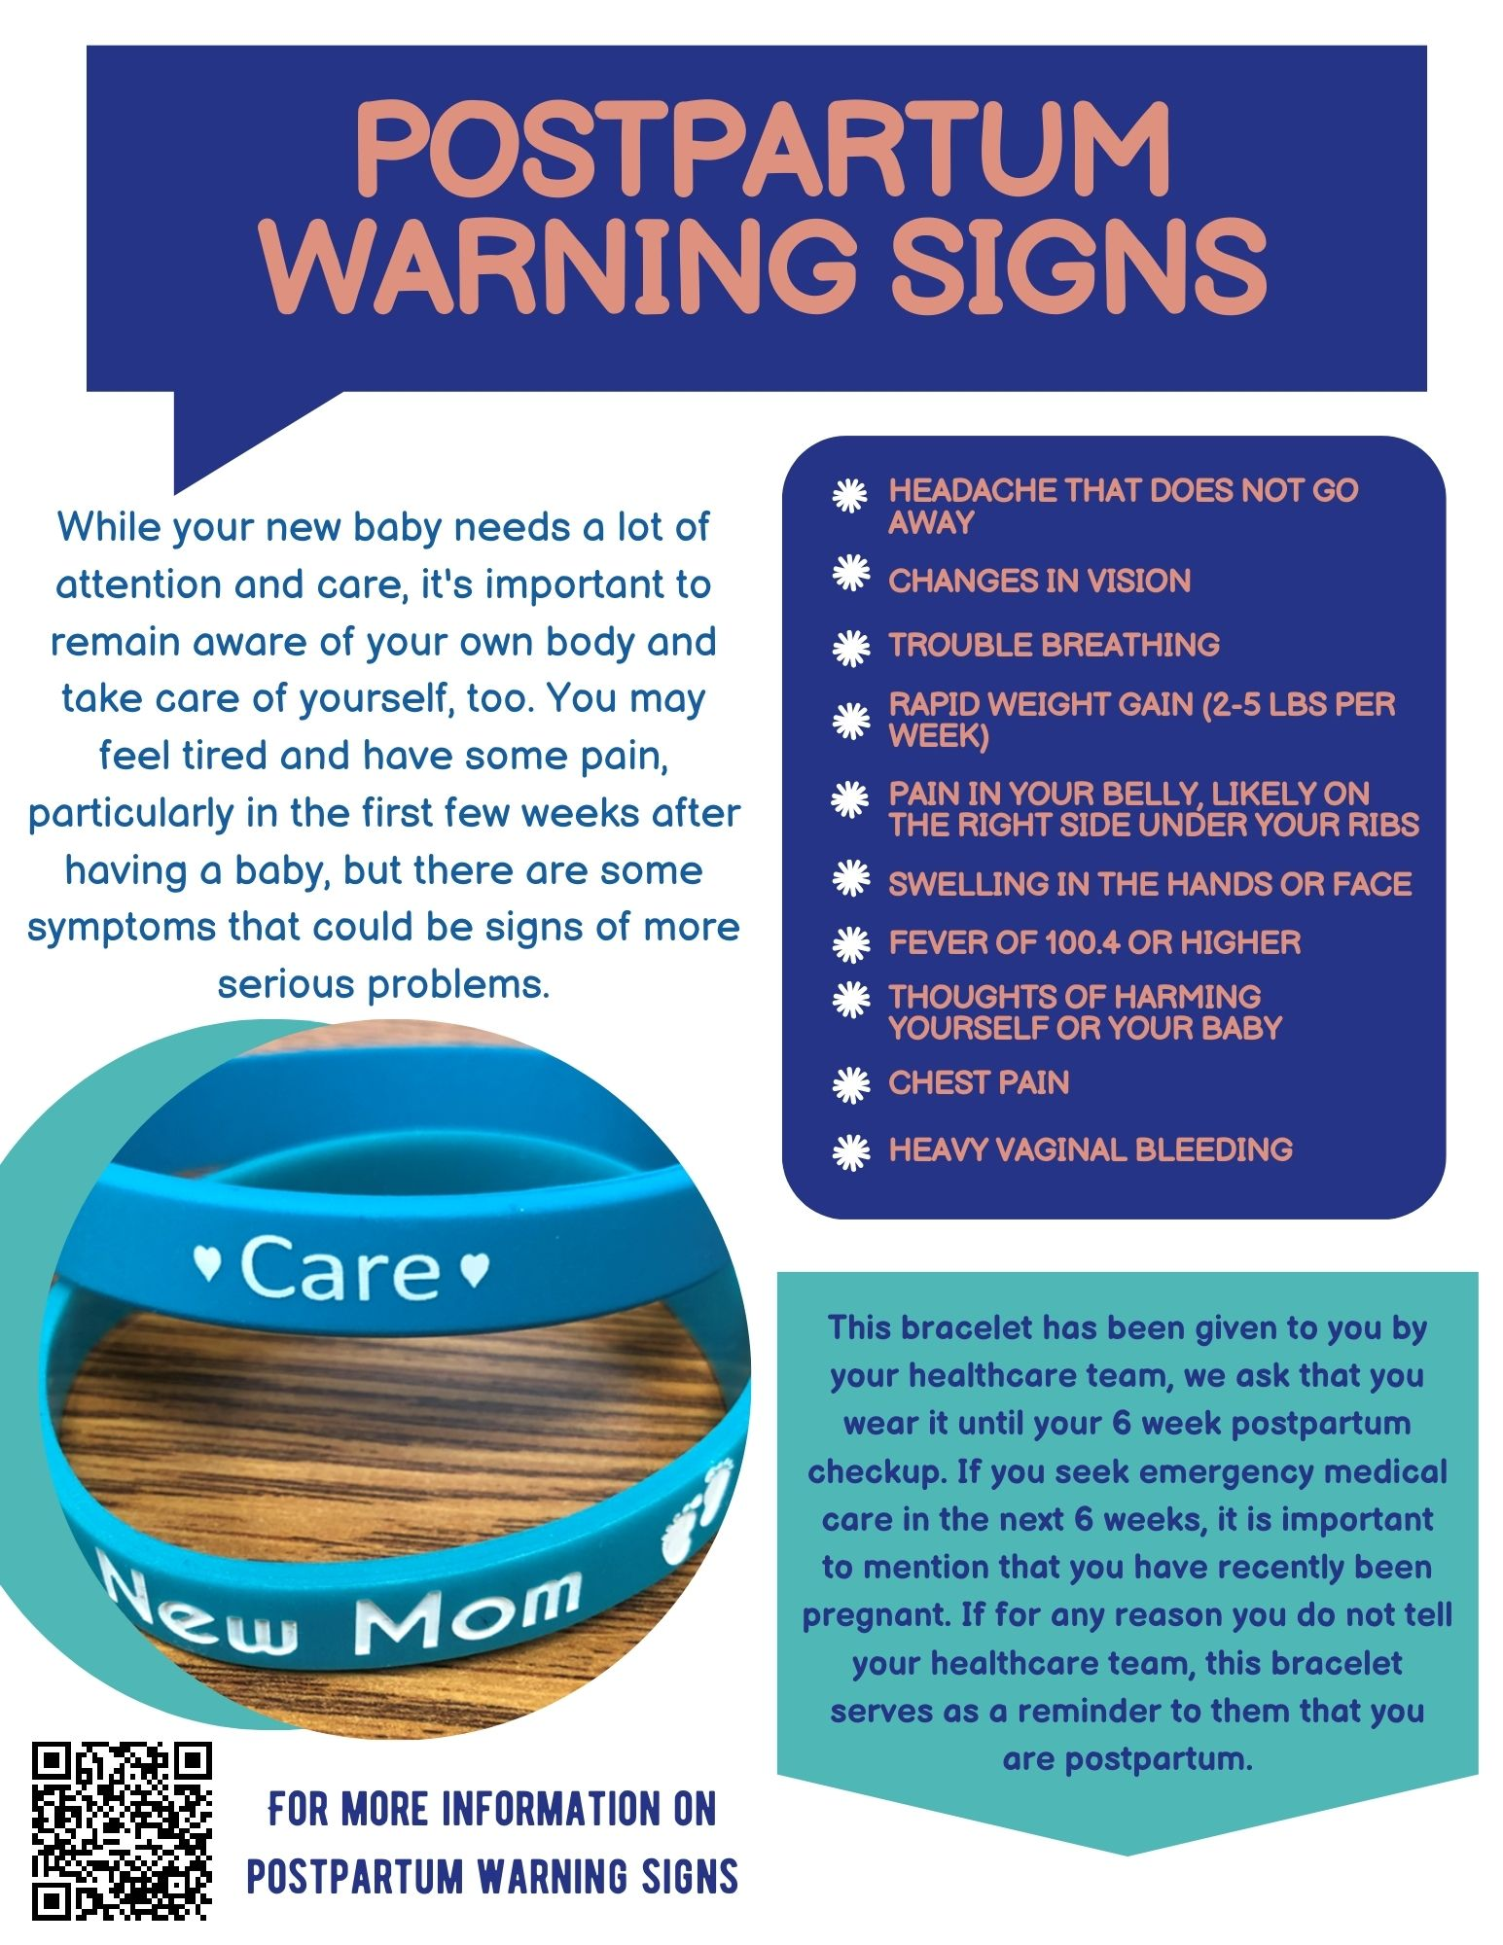
Sample Patient Flyer
Notes:
If received well, can have translated into different languages

Slide 4
HIE Project

Slide 5
Old Education

Slide 6
New Education

Slide 7
Class Offerings

Slide 8
FUNDAMENTALS OF FETAL MONITORING (FOFM)
Audience: Novice Registered Nurses in the State of Illinois who will be providing fetal monitoring to antepartum and intrapartum patients.
Time commitment – 8 hours – CEU’S will be available.
Virtual
Content will be presented every month at the state level.
These classes will be taught by Illinois Administrative Perinatal Center Educators.
For more information, please contact Jen at Jennifer.L.Carius@osfhealthcare.org

Slide 9
AWHONN Intermediate Fetal Monitoring Course
Audience - Nurses who have completed Updates in Fetal Monitoring/Basic Fetal Monitoring/Fundamentals of Fetal Monitoring.
One year of experience with fetal monitoring interpretation is recommended.
Time commitment – 8 hour in person class.
There will be on-line coursework that must be completed prior to class (approximately 2-4 hours).
October 14, 2024 (1 seat left).
To register and find available classes, please visit Contact us | North Central Perinatal Outreach (nciperinatal.com)
This class is free, the only cost associated is the cost of the book required by AWHONN to attend and complete the course.

Slide 10
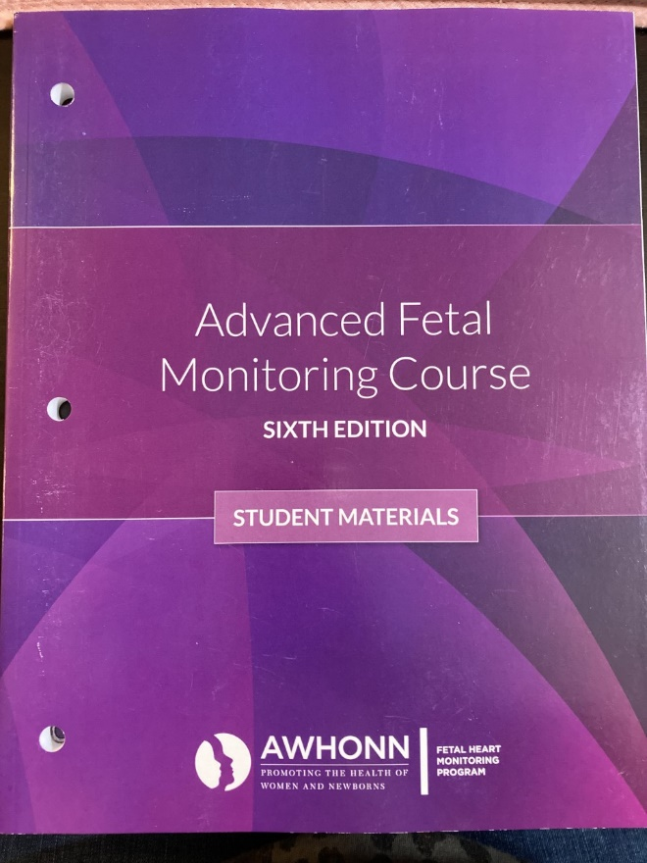
AWHONN Advanced Fetal Monitoring Course
Audience - Experienced Nurses who have taken the AWHONN Intermediate Fetal Monitoring Course or are certified in fetal monitoring.
Time commitment – 8 hour virtual class.
Classes remaining for 2024
September 30 – FULL
November 18 – Few seats available
To register and find available classes, please visit Contact us | North Central Perinatal Outreach (nciperinatal.com)
This class is free, the only cost associated is the cost of the book required by AWHONN to attend and complete the course.

Slide 11
AWHONN Classes for 2025
Course content is currently being updated for Intermediate and Advanced.
Contact hours: IFM: 11.5 and AFM: 8
Classes should be offered starting in the Spring.
Current course materials expire on 1/31/2025.
Probable increase in the cost of materials.

Slide 12
Spinning Babies 2024
Workshop with Tammy Ryan AdvCBD/BDT(DONA), SpBT
September 26, 2024 | 9:00-5:00 – In person
OSF Ministry Headquarters – Basement Conference Room
124 SW Adams St.
Registration information will be posted on website

Slide 13
PREPARING FOR THE EXPECTED
Audience: RNs who provide care across the spectrum of perinatal services, particularly in LDRP settings, but anyone with a basic understanding of EFM and newborn resuscitation is welcome! Interdisciplinary participation with RTs/MDs etc is always encouraged!
Time commitment: 3 hours, in person learning facilitated in-situ
Content: Following a brief review of EFM principles, a multiple case-study format is used to follow a maternal history, her labor course and EFM tracing with an emphasis on anticipating the correlating care needs of a newborn.
Then, learners simulate the newborn stabilization following delivery.
Approved for 3 CEUs
Contact Jen or Emalee if interested in scheduling sessions for your staff
In support of improving patient care, Jump Trading Simulation & Education Center is jointly accredited by the Accreditation Council for Continuing Medical Education (ACCME), the Accreditation Council for Pharmacy Education (ACPE), and the American Nurses Credentialing Center (ANCC), to provide continuing education for the healthcare team.

Slide 14
Basics of Newborn Assessment and Care
Geared towards nurses on orientation with minimal OB experience
Approximate class time: 2 hours
Will offer quarterly virtual class for entire network starting in January 2025
Can schedule private in-person class for groups more than 4 nurses
Reach out to Emalee for more information
Beneficial to take as a pre-course to STABLE and/or FONAC

Slide 15
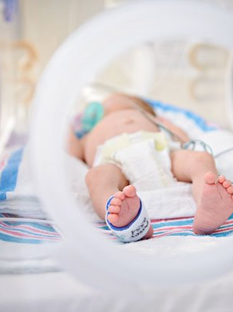
Red Flags in Newborn Care
Basic overview of conditions that need close monitoring and intervention
Intended for nurses with less than 6 months of experience
Ideally taught in person with a hands-on portion
Approximate class time: 1 hour didactic, 1 hour hands-on
Please contact Emalee at Emalee.P.Brink@osfhealthcare.org if you are interested in scheduling a session

Slide 16
S.T.A.B.L.E. - 6th Edition
September 10, 2024
November 14, 2024
December 11, 2024 at St. Elizabeth (Ottawa)
[Seats may be available to network]
Book is required for the course. Books will not be provided
CEUs available for $20 course fee (9.6 contact hours)
Instructor:
Christina M. Spurgeon, MSN, APRN, NNP-BC
Neonatal Nurse Practitioner
Children’s Hospital of Illinois NICU

Slide 17
S.T.A.B.L.E. 7th Edition
Plan to offer a class each quarter
2 classes at OSF Ministry Headquarters (Peoria)
2 classes somewhere in the region
If you would like to host, please contact Emalee
There will be a fee associated with S.T.A.B.L.E. prework
Discounted rate if hospital purchases seats
Nurse Grid Learn, $54 per learner
STABLE Foundations course required before in-person course
In-person course will remain free
Opportunity for hands-on learning
Recommended to take every 2 years
CEUs offered through Jump Simulation

Slide 18
Wish List: Future Education Projects
Maternal Cardiac Arrest Simulation
Hemorrhage/Hypertension Escape Room
Neonatal Escape Rooms
Pre-transport stabilization course for LMS
Cardiac STABLE
Updated EMS/ED education
NICU reference guide for referring hospitals
One-pager education on website

Slide 19
If you have specific education requests, please reach out to Jen and Emalee.
Jennifer.L.Carius@osfhealthcare.org
Emalee.P.Brink@osfhealthcare.org

