Slide 1
NCIPN Regional Quality Council
April 25, 2024
Wozniak Learning Academy and Teams

Slide 2
Introductions: Name Facility What do you enjoy the most about Spring?

Slide 3
Agenda

Slide 4
Congenital Syphilis – Anne Stanton & Dr. Olaya

Slide 5
Break

Slide 6
Welcome – Tonya Hedges!
IDPH Perinatal Nurse Consultant
IDPH Updates

Slide 7
Education Updates
Jen Carius, Maternal Perinatal Outreach Educator
Emalee Brink, Neonatal Perinatal Outreach Educator

Slide 8
NCIPN Review

Slide 9
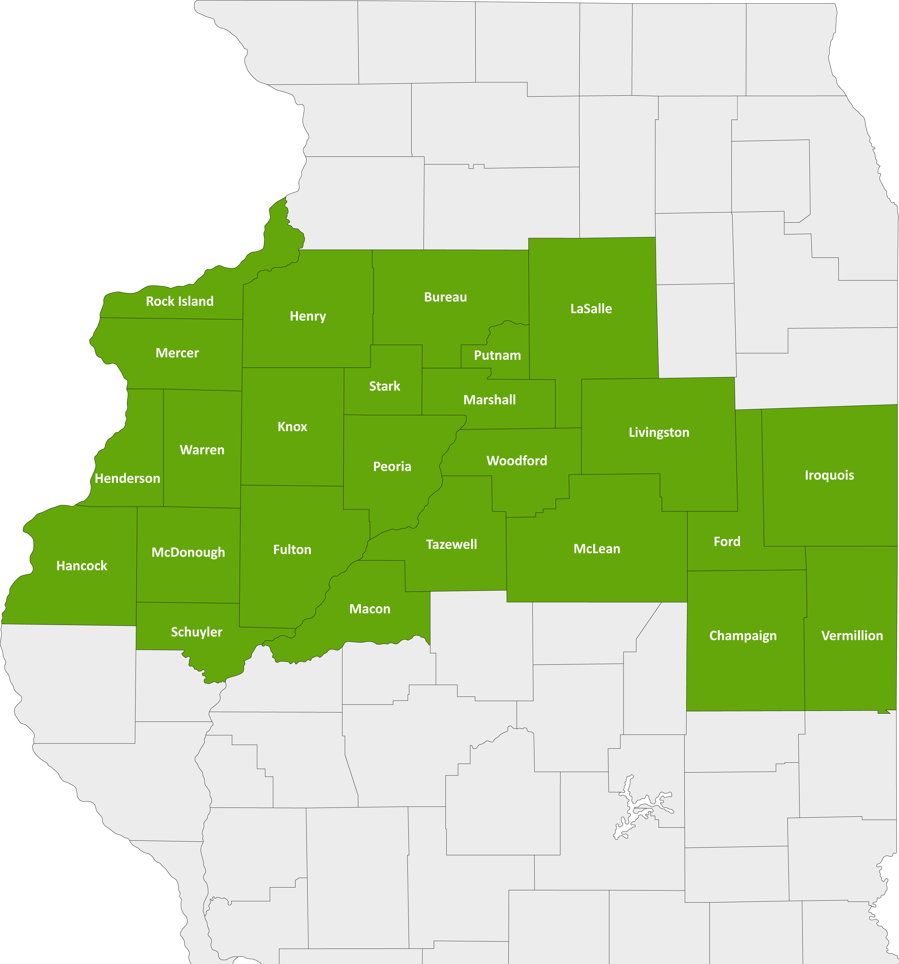
North Central Illinois Perinatal Network
The NCIPN covers 25 counties and 27 hospitals. Our administrative perinatal center (APC) is OSF HealthCare Saint Francis Medical Center in Peoria.
An APC facility provides
Education
Case reviews
Site visits for level of care re-designations
An on-call maternal-fetal medicine physician and neonatologist for consultation, support and supervision of transfers

Slide 10
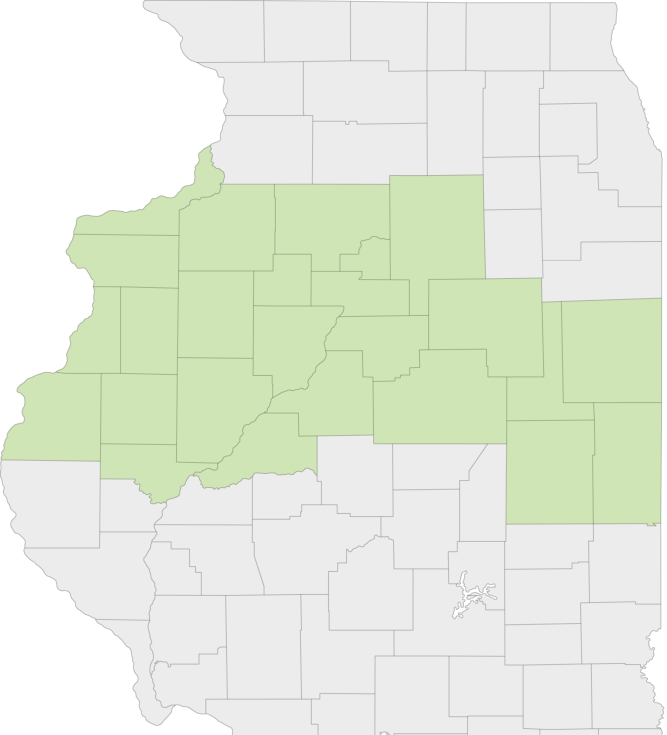
Current State Nursery Levels
LEVEL III – Provides care for patients requiring increasingly complex care and has a NICU.
LEVEL IIE – Has extended neonatal capabilities and provides care to pregnant women and newborns at moderate risk. No NICU or special care nursery.
LEVEL II – Provides care to women with low-risk pregnancies. Operates intermediate care nursery but no NICU or special care nursery.
LEVEL I – Hospitals that provide care to low-risk pregnant women and newborns, operate general care nurseries and do not operate an NICU or Special Care Nursery.
LEVEL 0 – No obstetrics services

Slide 11
North Central Illinois Perinatal Network Hospitals
Level III
OSF Saint Francis – Peoria
Level IIE
UnityPoint Health-Methodist – Peoria
UnityPoint Health-Trinity – Moline
Level II
Carle BroMenn – Normal
Genesis – Illini Campus – Silvis
Graham – Canton
OSF Saint Elizabeth – Ottawa
OSF St. Mary – Galesburg
McDonough District Hospital – Macomb
OSF St. Joseph – Bloomington
OSF Sacred Heart - Danville
Level I
LEVEL 0 – No maternity services
2
2
4
5
1
1
6
3
7
6
1
8

Slide 12
North Central Illinois Perinatal Network Hospitals
Level III
Level IIE
Level II
Level I
Level 0
Level 0 – no maternity
Genesis – Aledo
Hammond Henry – Geneseo
Iroquois – Watseka
OSF Center for Health – Streator
OSF Saint Clare – Princeton
OSF Saint Paul – Mendota
OSF St. James - Pontiac
OSF Holy Family – Monmouth
OSF Saint Luke – Kewanee
UnityPoint Health-Pekin – Pekin
UnityPoint Health-Proctor – Peoria
Carle Eureka – Eureka
Hopedale Medical Complex – Hopedale
Memorial Hospital – Carthage
OSF Heart of Mary – Urbana
OSF St. Elizabeth’s - Peru
2
6
5
16
9
1
4
8
7
11
3
12
10
14
13
15

Slide 13
Historical Look at OB Closures
2014
Perry Memorial – Princeton (85/yr)
2017
Hammond Henry – Geneseo (240/yr)
2019
Cottage Hospital – Galesburg (370/yr)
St. Mary’s – Streator (186/yr)
Proctor Community Hospital – Peoria (604/yr)
Iroquois Memorial – Watseka (89/yr)
Pekin Hospital – Pekin (367/yr)

Slide 14
Historical Look at OB Closures
2023
St. Margaret Health – Peru (364/yr)
2022
St. Margaret Health – Spring Valley (269/yr)
Memorial Hospital – Carthage (101/yr)

Slide 15
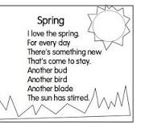
Maternal & Newborn Workgroups

