Slide 1
Hypertension-Preeclampsia

Slide 2
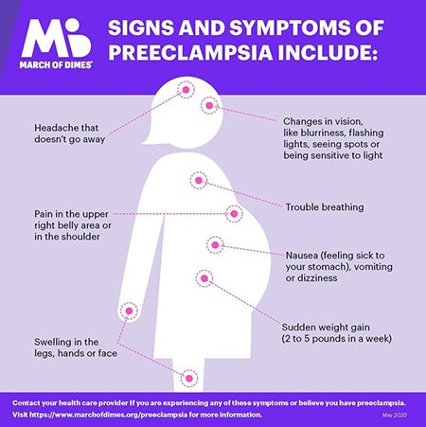
Hypertension – Is it Chronic?
Many women have preexisting conditions affecting pregnancy, STILL need evaluation!
Is it Preeclampsia??
Preeclampsia can develop between 20 weeks to 6 weeks postpartum
Symptoms:
Blurred vision
Headache
Epigastric pain
N/V
Swelling (hands, face, feet)
: Protein Creatinine ratio >0.3
Elevated B/P > 140 Systolic > 90 diastolic
Severe >160 Systolic and or > 110 diastolic

Slide 3
Key Clinical Pearl
Patients presenting pregnant or 6 weeks postpartum with vague symptoms of:
headache
abdominal pain
shortness of breath
generalized swelling
complaints of “I just don’t feel right”
should be evaluated for atypical presentations of preeclampsia or “severe features”
Notes:
If pregnant or delivered with in the last 6 weeks, watch for these vague symptoms.

Slide 4
Accurate B/P

Slide 5
B/P Assessment
Take time to use correct equipment and measure her arm
Position the woman correctly
Initial blood pressure should be assessed after the woman has been resting with minimal distraction for 5 minutes.
BP ≥160/110 lasting for 15 minutes should be treated in under 30-60 minutes
Initial BP is ≥
140 systolic OR
≥ 90 diastolic
Take in the same arm
Initial BP is ≥
160 systolic or
≥ 110 diastolic
Notify provider after first elevated BP
Reassess after 15 minutes
Do not reposition to side-lying
Activate treatment algorithms if remains ≥160/110
Repeat blood pressure in 15 minutes
Evaluate for preeclampsia
Activate Severe HTN Treatment Algorithm
Notes:
There are several key elements to accurate blood pressure. (read slide)

Slide 6
Need
To
Treat*
BP ≥
160/110
*BP persistent 15 minutes, activate treatment algorithm with IV therapy ASAP, < 30-60 minutes

Slide 7
Antihypertensive Therapy: First Line Agents
IV Labetalol (Normadyne)
IV Apresoline (Hydralazine)
PO Nifedipine (Procardia)
Beta blocker (some
alpha)
Caution with heart rate < 60, congenital heart failure, AV heart block or asthma
Neonatal bradycardia
Repeat after 10 minutes
Vasodilator
Watch for rebound tachycardia or hypotension
Caution with Heart rate > 100, recent stroke, severe mitral valve disease
Can repeat after 20 minutes
Calcium channel
blocker
Caution with heart rate > 100, severe aortic stenosis, recent MI, cardiogenic shock
OK to use with concomitant magnesium sulfate
Notes:
Labetalol is the most used antihypertensive medication in pregnancy

Slide 8
Severe Hypertension Treatment Algorithm
SBP > 160 and/or DBP > 110
Provider Notified
IV Anti-Hypertension Meds
First Line Medications
Blood Pressure Triggers
SBP ≥ 160 and/or DBP ≥ 110
Repeat in 15 minutes.
Notify Provider and Proceed
IV Access
FHR monitoring (if applicable)
Labs per PIH Order Set Pulse Oximeter
Seizure Prophylaxis
IV Labetalol
20 mg (over 2 min)
IV Hydralazine
5 or 10mg (over 1-2 min)
Per physician’s order
Magnesium Sulfate
Repeat BP in 10 min
If elevated, administer
IV Labetalol 40 mg
Repeat BP in 20 min
If elevated, administer
IV Hydralazine 10 mg
Bolus Dose: 4gm over 20 minutes
Maintenance Dose: 2gm per hour
Repeat BP in 10-15 min If elevated, administer
IV Labetalol 80 mg
Repeat BP in 20 min
If elevated, administer
IV Hydralazine 10 mg
PO Nifedipine If no IV access Initial Dose: 10 mg
May repeat dose at 20 minute intervals for a
maximum of 5 doses.
Repeat BP in 20 min
If elevated,
IV Hydralazine
pre algorithm
anesthesia consult
Repeat BP in 20 min
If elevated, IV Labetalol 20 mg
pre algorithm
anesthesia consult
Notes:
Example of a CMQCC Algorithm used in California. Algorithm’s should be posted and readily available. NOTE the Magnesium is started at the same time of treating the BP. Should not wait for protein results or wait 6 hours to confirm preeclampsia diagnosis. Seizure prevention should be part of treatment for Severe Maternal HTN. These IV BP medication protocols have been updated with the ACOG Acute Treatment of Severe HTN Committee Opinion April, 2017, #692.

Slide 9
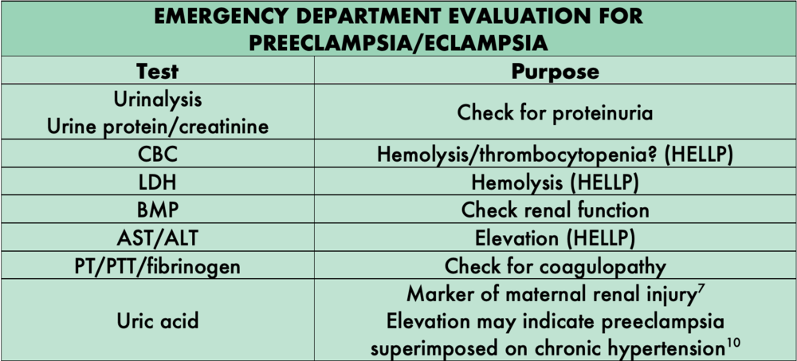
Treatment/Labs
CMP – specifically looking at AST/ALT
CBC – specifically looking at PLT/Hgb
Uric Acid
LDH
Protein/Creatinine Ratio
UA
Coag Profile
Start second IV

Slide 10
Risk Factors - ACOG
Risk factors for women at high risk include
Preeclampsia in a past pregnancy
Carrying more than one fetus
Chronic high blood pressure
Kidney disease
Diabetes mellitus
Autoimmune conditions, such as lupus
Risk factors for women at moderate risk include
Being pregnant for the first time
Being pregnant more than 10 years after your previous pregnancy
Body mass index (BMI) over 30
Family history of preeclampsia (mother or sister)
Being age 35 or older
Complications in previous pregnancies, such as having a baby with a low birth weight
In vitro fertilization (IVF)
Black race (because of racism and inequities that increase risk of illness)
Lower income (because of inequities that increase risk of illness)

Slide 11
Major Morbidities
Stroke
Placental Abruption
Eclampsia
Cerebral Edema/PRES
Renal Failure
Hemorrhage/DIC
Pulmonary Edema
Liver Hematoma/Rupture

Slide 12
Preeclampsia Awareness
~Me First Bracelets
~ Given to patients who have delivered
~ “Care” is for patients whose baby does not come home with them
~ Patients wear until they are seen by provider at the 6 week postpartum visit

Slide 13
Key Points
Systolic over 160 or diastolic over 110 – sustained – needs immediate treatment
Magnesium sulfate is used to prevent seizures
Labs are important to evaluate if patient is developing HELLP syndrome
There is a HTN in pregnancy algorithm – use it to help the provider navigate how to treat preeclampsia
Preeclampsia can happen in the postpartum period up to 6 weeks

