Slide 1
NCIPN ~ Regional Quality Meeting
Thursday, August 31, 2023
Via Teams

Slide 2
Reflection

Slide 3
Welcome & Introductions
In a “perfect” world, what is the one thing you would want for your
Unit
Staff
Providers
Patients
Self
What tools/resources would you need?
Have you thought about making those dreams a reality?

Slide 4
Sudden Unexpected Postnatal Collapse
Guest Speakers

Slide 5
Guest Speakers
Sudden Unexpected Postnatal Collapse (SUPC)
Lisa Festle, MSN, RNC-NIC, APRN/CNS ~ Neonatal Outreach Educator ~ Loyola University Medical Center
Stephanie Loiacono, BSN, MS, RNC-OB, CBC, ~Maternal Outreach Educator ~ Loyola University Medical Center

Slide 6
Network Updates

Slide 7
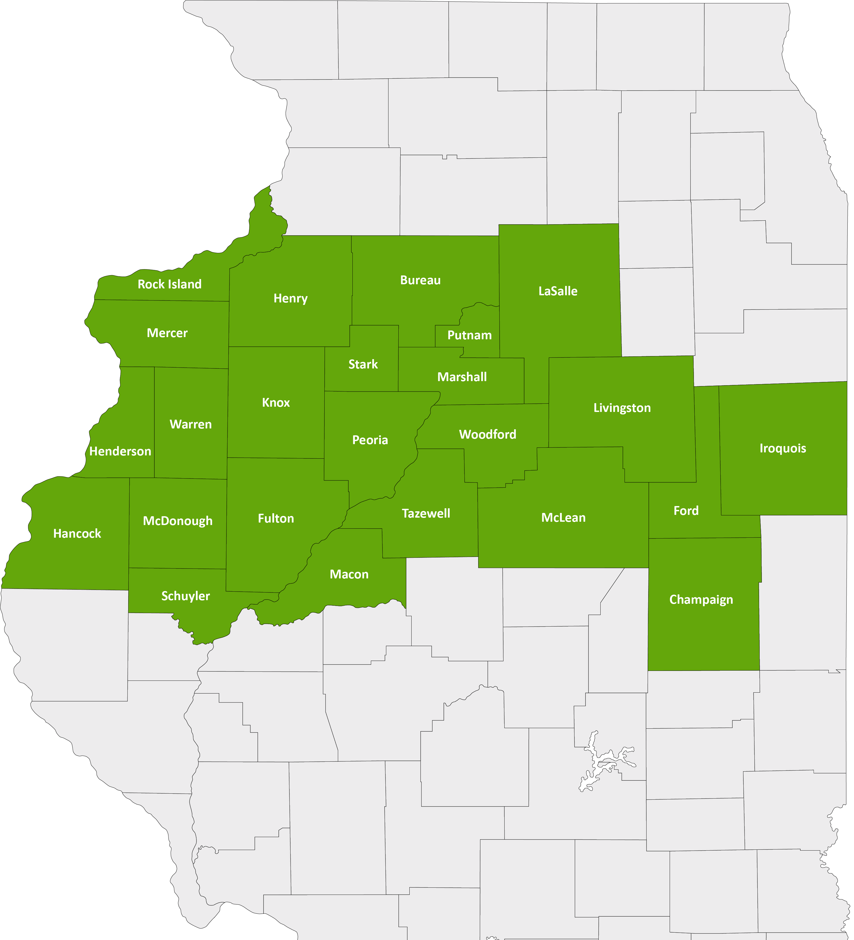
North Central Illinois Perinatal Network
The NCIPN covers 24 counties and 26 hospitals. Our administrative perinatal center (APC) is OSF HealthCare Saint Francis Medical Center in Peoria.
An APC facility provides
Education
Case reviews
Site visits for level of care re-designations
An on-call maternal-fetal medicine physician and neonatologist for consultation, support and supervision of transfers
Representation with IDPH

Slide 8
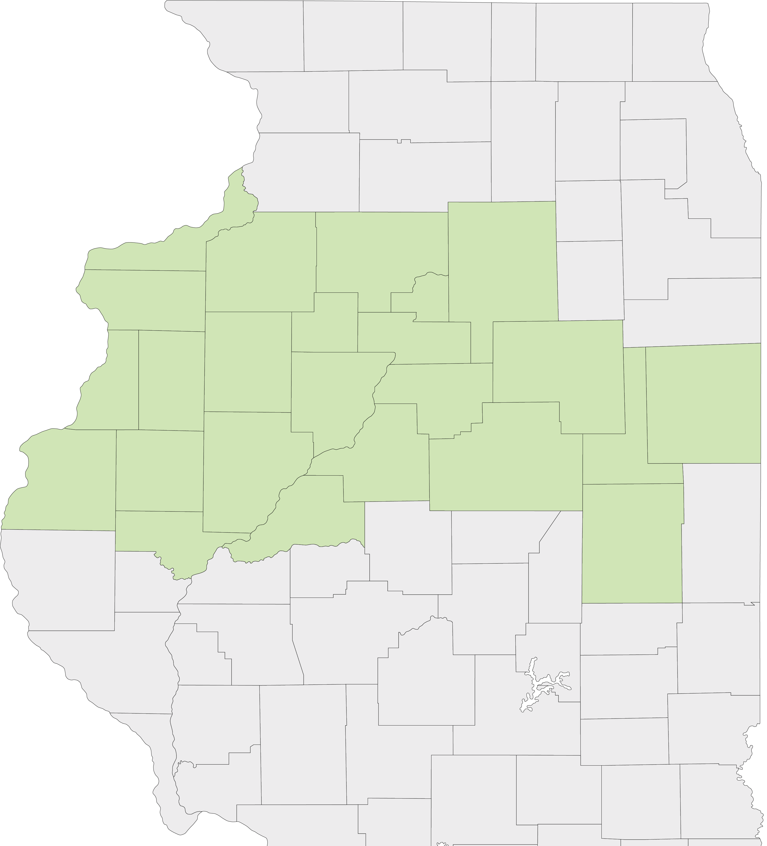
Current State Nursery Levels
LEVEL III – Provides care for patients requiring increasingly complex care and has a NICU.
LEVEL IIE – Has extended neonatal capabilities and provides care to pregnant women and newborns at moderate risk. No NICU or special care nursery.
LEVEL II – Provides care to women with low-risk pregnancies. Operates intermediate care nursery but no NICU or special care nursery.
LEVEL I – Hospitals that provide care to low-risk pregnant women and newborns, operate general care nurseries and do not operate an NICU or Special Care Nursery.
LEVEL 0 – No obstetrics services

Slide 9
North Central Illinois Perinatal Network Hospitals
Level III
OSF Saint Francis – Peoria
Level II+
Carle Health-Methodist – Peoria
Unity Point Health-Trinity – Moline
Level II
Carle BroMenn – Normal
Genesis – Illini Campus – Silvis
Graham – Canton
OSF Saint Elizabeth – Ottawa
OSF St. Mary – Galesburg
McDonough District Hospital – Macomb
OSF St. Joseph – Bloomington
Level I
None
LEVEL 0 – No maternity services
2
2
4
5
1
1
6
3
7
6
1

Slide 10
North Central Illinois Perinatal Network Hospitals
Level III
Level IIE
Level II
Level I
Level 0
Level 0 – no maternity
Genesis – Aledo
Hammond Henry – Geneseo
Iroquois – Watseka
OSF Center for Health – Streator
OSF Saint Clare – Princeton
OSF Saint Paul – Mendota
OSF Holy Family – Monmouth
OSF Saint Luke – Kewanee
Carle Health-Pekin – Pekin
Carle Health-Proctor – Peoria
Carle Eureka – Eureka
Hopedale Medical Complex – Hopedale
Memorial Hospital – Carthage
OSF St. James – Pontiac
OSF Heart of Mary - Urbana
2
6
5
8
1
4
7
14
10
3
11
9
13
12
15

Slide 11
Changes…
As of September 1, 2023:
10 Delivering Hospitals
15 Non-Delivering Hospitals
1 Potential opening of ER services in Peru
Increase patient load on delivering hospitals?

Slide 12
OSF Saint James ~ Pontiac
Closing OB Services September 1, 2023
Non-Delivering Hospital – Level 0 education in August
Over 25 people attended
Nicole Kutzner
Manager Patient Care, Family Birthing Center at OSF St Joseph Medical Center

Slide 13
OSF Heart of Mary Medical Center ~ Urbana
Closing OB Services September 1, 2023
Non-Maternity Service Hospital – Level 0 Education
Over 30 people attending
Robyn Lindenmeyer serving as Nursing Director for Heart of Mary Medical Center
Cristy Shafer serving as Manager for Telemetry at Heart of Mary Medical Center

Slide 14
OSF Sacred Heart ~ Danville
Opening as a Level II September 2, 2023
Brittany Jones ~ Manager
Providers from Carle Health and OB HG group, including CNM
Neonatology
Petitioned to change APC’s

Slide 15
When YOU have changes… Please reach out!
Please let us know when there will be changes in your department
Email Group Contacts
Changes in Roles/Responsibilities

Slide 16
Honoring Janessa Jenkins, MSN, APRN, NNP-BC
Served Perinatal Outreach as Neonatal Outreach Educator since 2018
Over 18 years with OSF HealthCare Children’s Hospital of Illinois as bedside RN and NNP.
Janessa is joining Carle BroMenn Level II Nursery Staff September 2023
Lifelong learner, educator and friend

Slide 18
IDPH & IL PQC Updates

Slide 19
IDPH
Maternal Levels of Care remain with IDPH, working on language and with legal
Maternal Morbidity and Mortality Report will be out Fall 2023
PLEASE send in your facilities compliance with Hemorrhage and HTN Education for 2020, 2021, 2022
Please complete data in ePerinet by the 15th of the next month
Redesignation Site Visits begin in 2024

Slide 20
IL PQC
Annual Conference November 2, 2023
I will send out updates to initiatives
www.ilpqc.org
Need help? Please reach out! Discuss in workgroups

Slide 21
Maternal/Newborn Workgroups
Choose which group you would like to be a part of
As a group, develop a plan with
Objectives
Plan
Resources Needed
Report out at the end of the day

Slide 22
Education Updates

Slide 23
www.nciperinatal.com

Slide 24
AWHONN OPS: OB Emergencies Workshop

Slide 25
AWHONN OPS
Maternal Morbidity
Mental Health & Traumatic Stress
SDOH
Cardiac Disease
Maternal Sepsis
Preeclampsia & HTN
Malignant Hyperthermia
EBL & QBL
Prolapsed Cord & Uterine Rupture
Post Birth Warning Signs
Anaphylactoid syndrome of pregnancy
Teamwork/Debriefing/Role Designation
Topics Covered

Slide 26
Educational Formats
Simulations
Escape Room
Skills Stations
Didactic Presentations
Videos

Slide 27
More Details
The cost for each attendee would be $120, which is the cost per AWHONN.
Self-paced online pre-coursework must be completed prior to the class.
Class size would be small (approximately10-12) due to how the material is presented. Class time would be from 0800-1600.
Nursing contact hours/pharmacy/CME: 10.75 hours (0.75 pharmacy hours) Nursing contact hours/CME available through 05/31/2025.

